Slide 1
Noodle Foodle
Re-design
Link to original noodle foodle website http://www.noodlefoodle.co.uk/

Slide 2
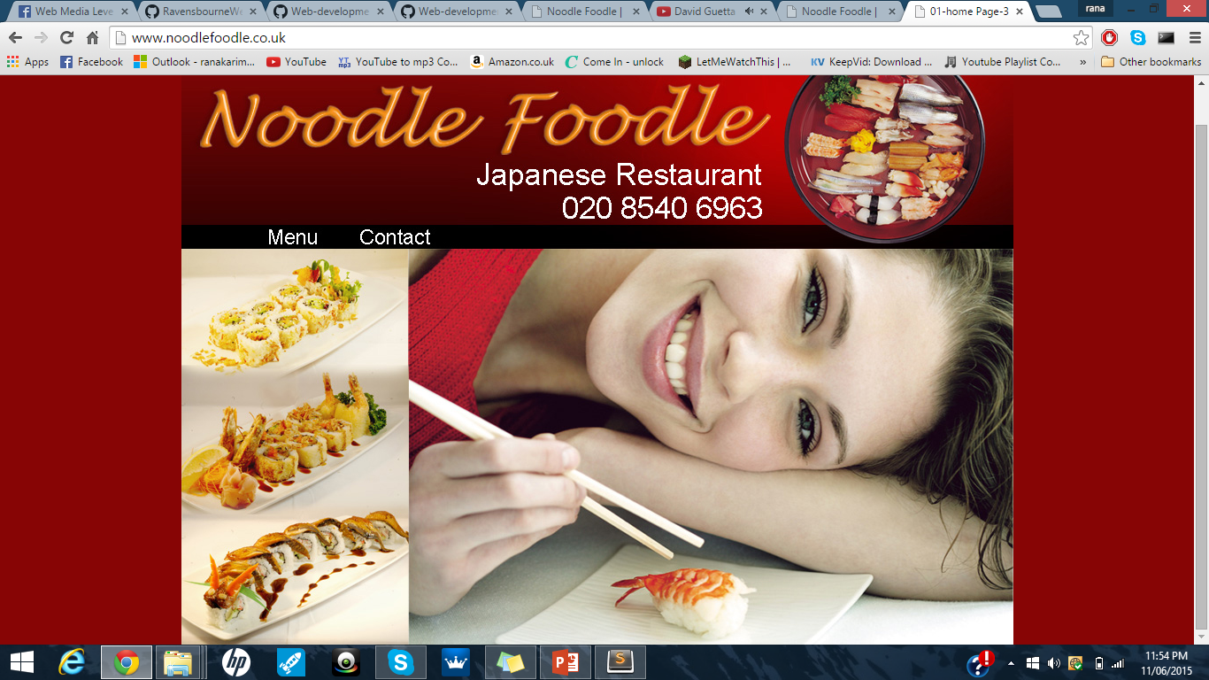
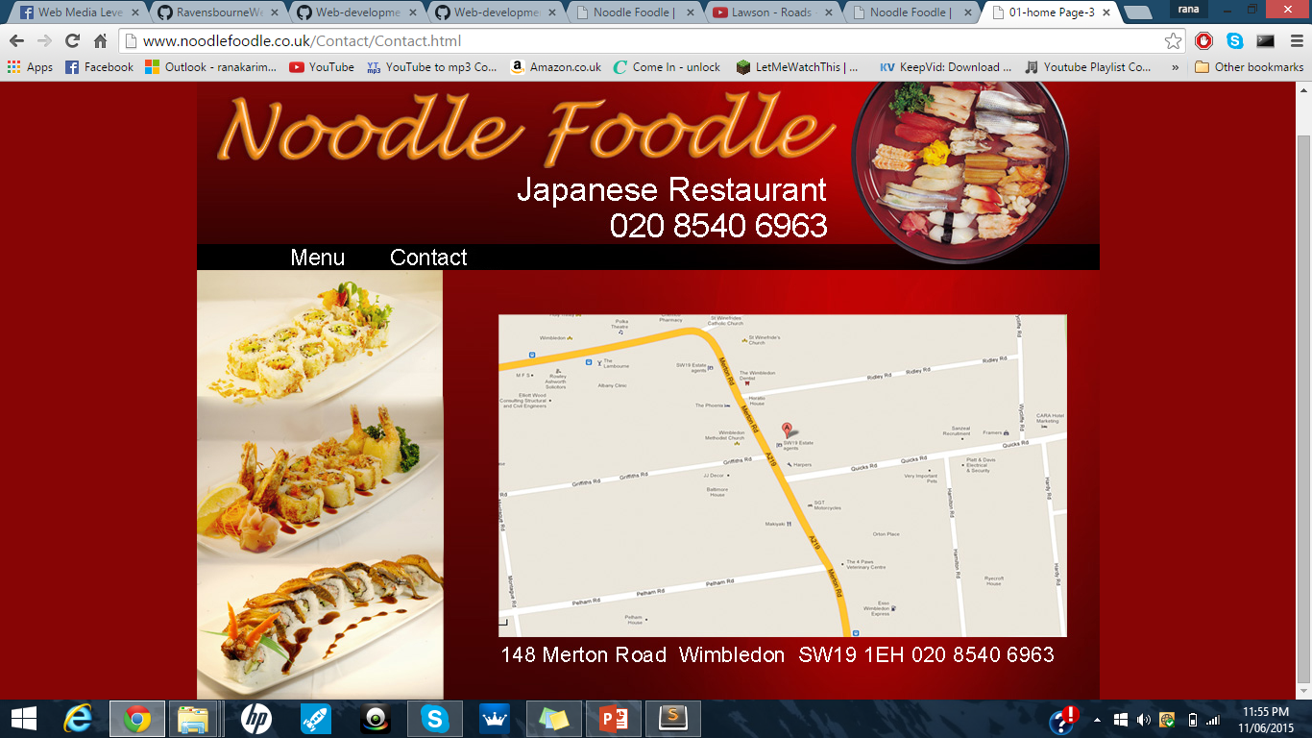
My project
Based on re-designing the Noodle Foodle website
This is a small local Japanese restaurant

Slide 3
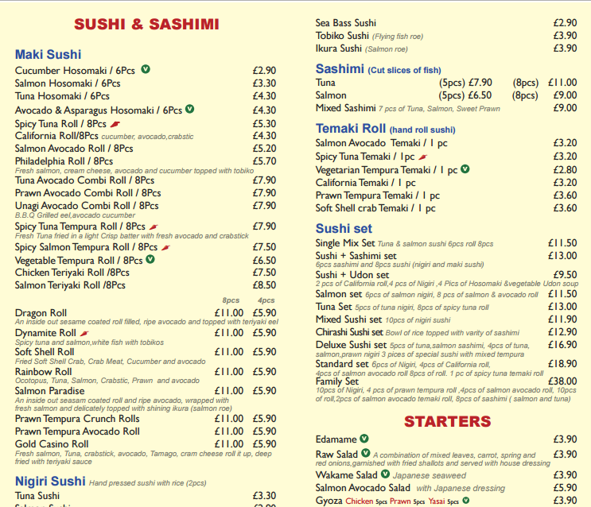
Research
Whats wrong?
Lack of content
Lack of interactivity
Irrelevant (browser provided majority of information on the website)
Amateur aesthetics and pre-dated
Not dynamic (menu is a PDF file probably photos to change or edit an item will be long process)
Link to full website review:
https://github.com/RanaKarim/WEB14104/blob/master/students/Rana/Blogging/Week%202%20(Bad%20websites)/Full%20website%20review%20Noodle%20Foodle.md

Slide 4
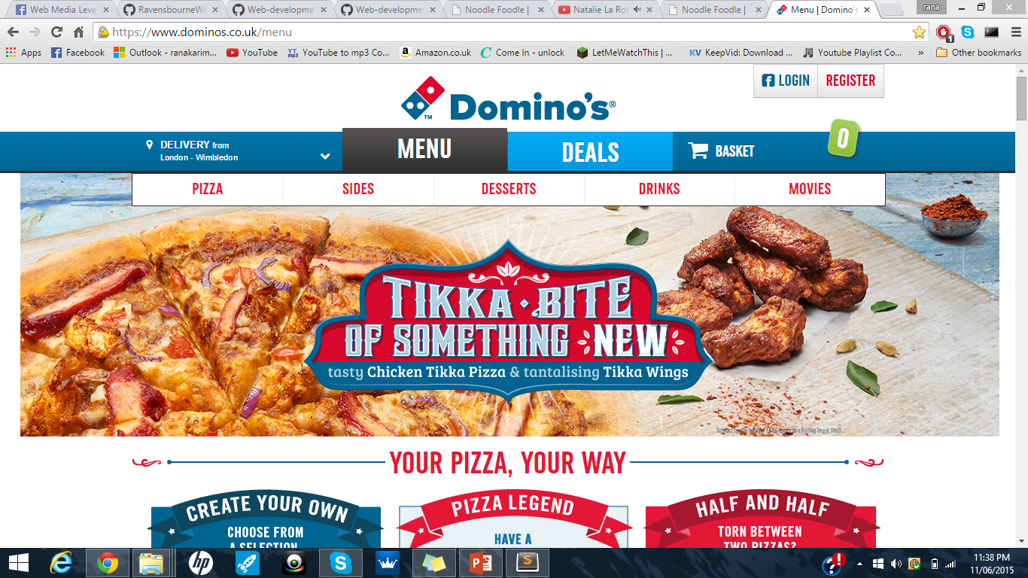
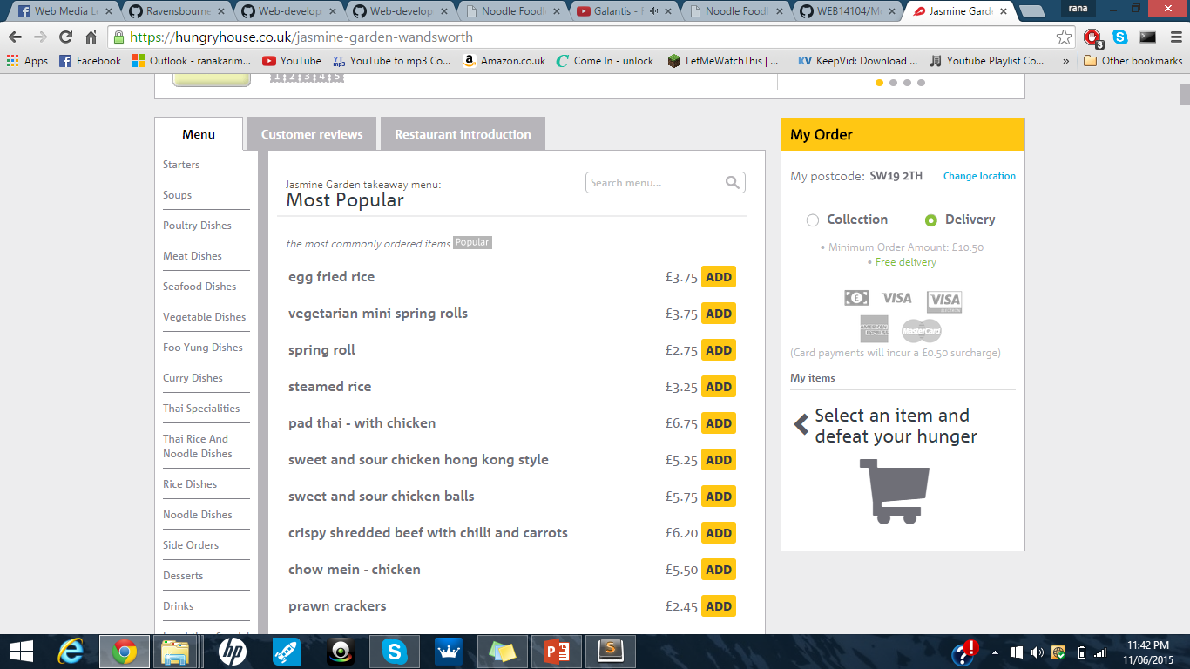
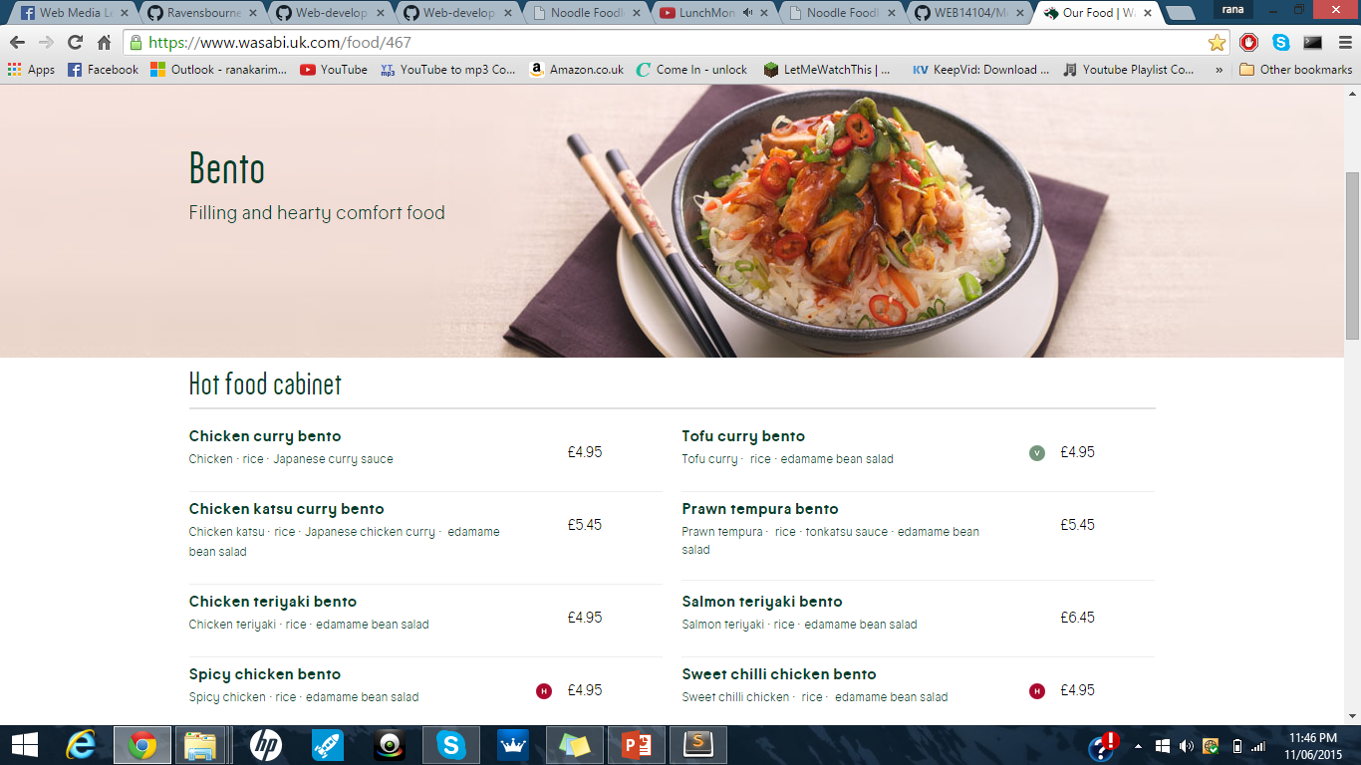
Research
Dominos (menu being split up)
Wasabi (header image/menu layout
Hungry house (Basket down the side)
Notes:
Research I done on other food shops , online delivery:
Dominos: liked the menu being split up
Wasabi: The header image and layout of the menu , very readable
Hungry house: Liked the basket on the side helps you remember what you orderd

Slide 5
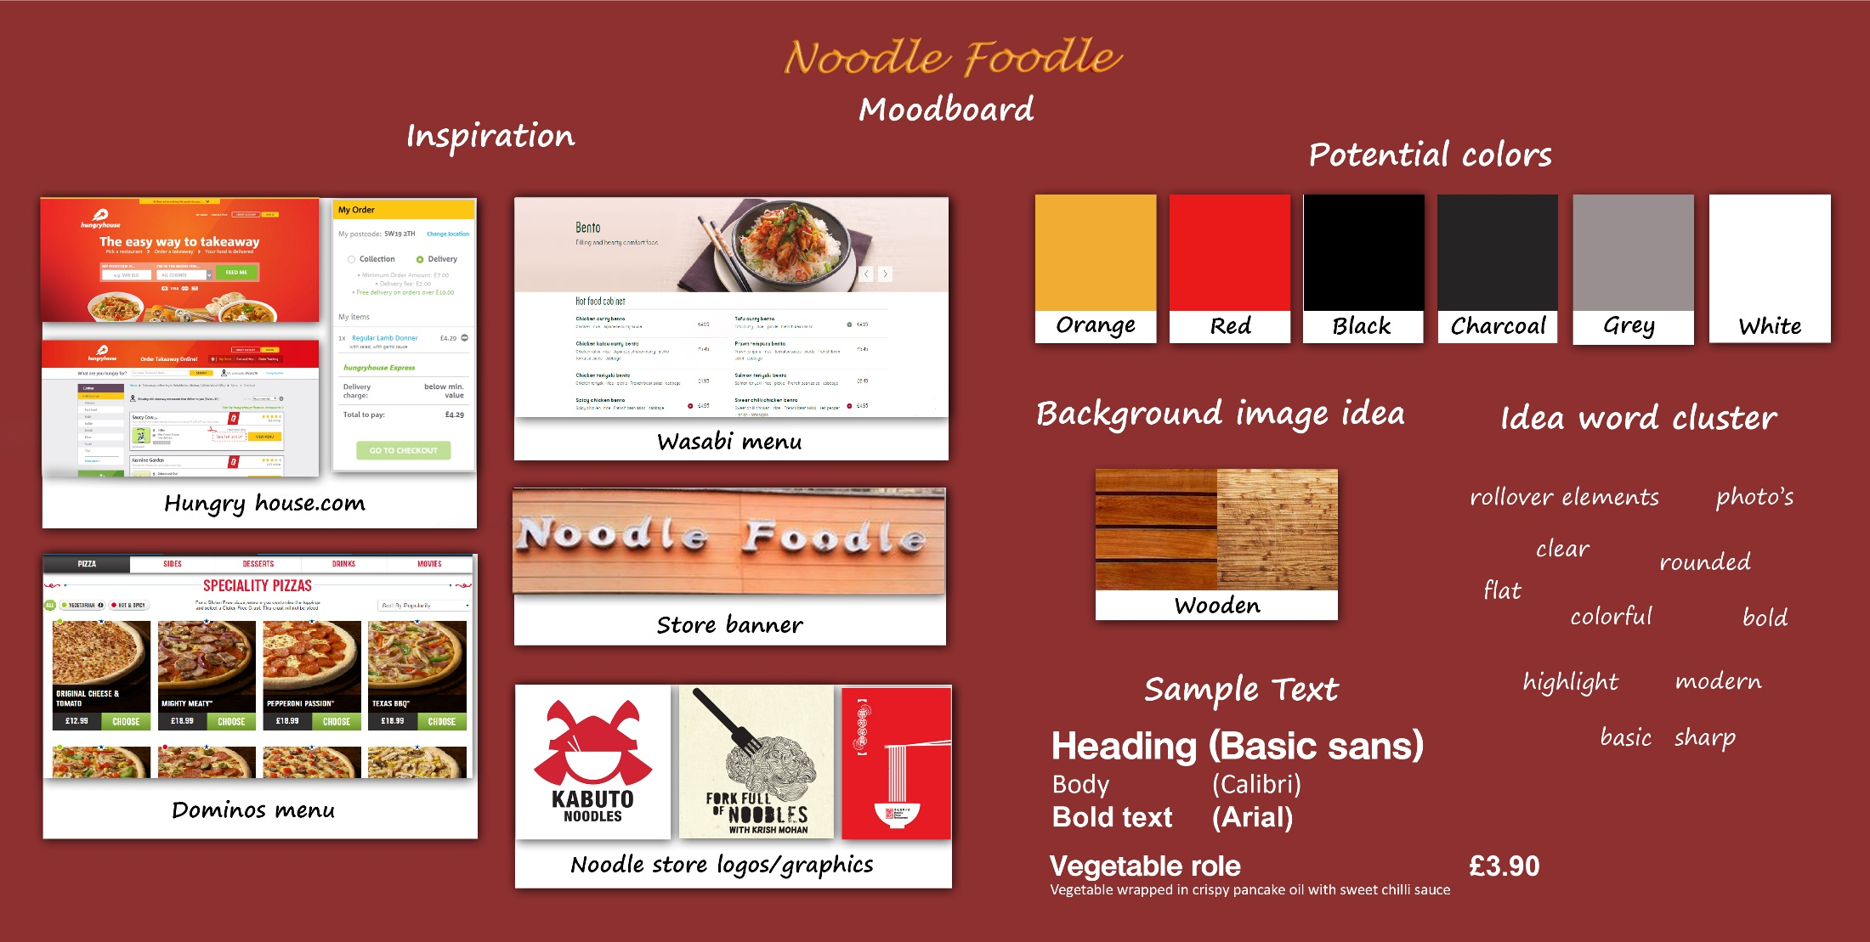
Research
Link to mood board: https://github.com/RanaKarim/WEB14104/blob/master/students/Rana/Moodboard%20V3.jpg

Slide 6
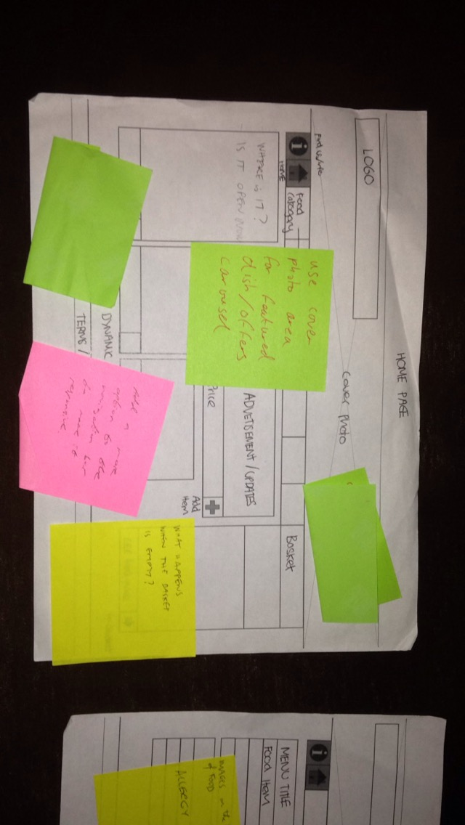
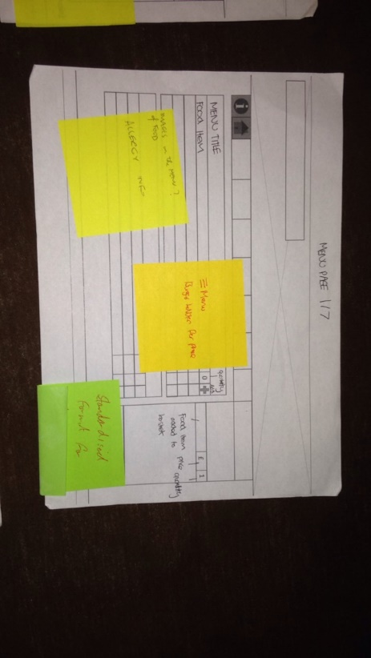
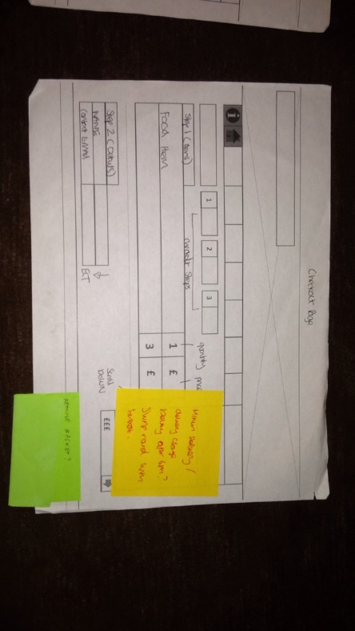
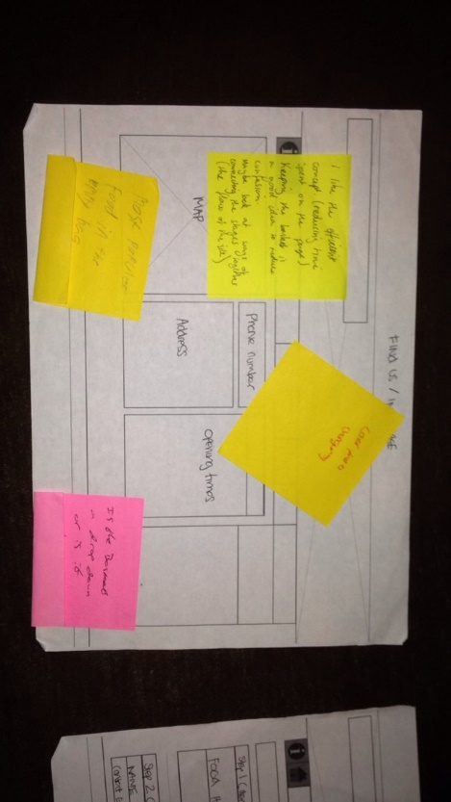
The process (Paper wireframes)
Paper wireframes, that were given feedback for development

Slide 7
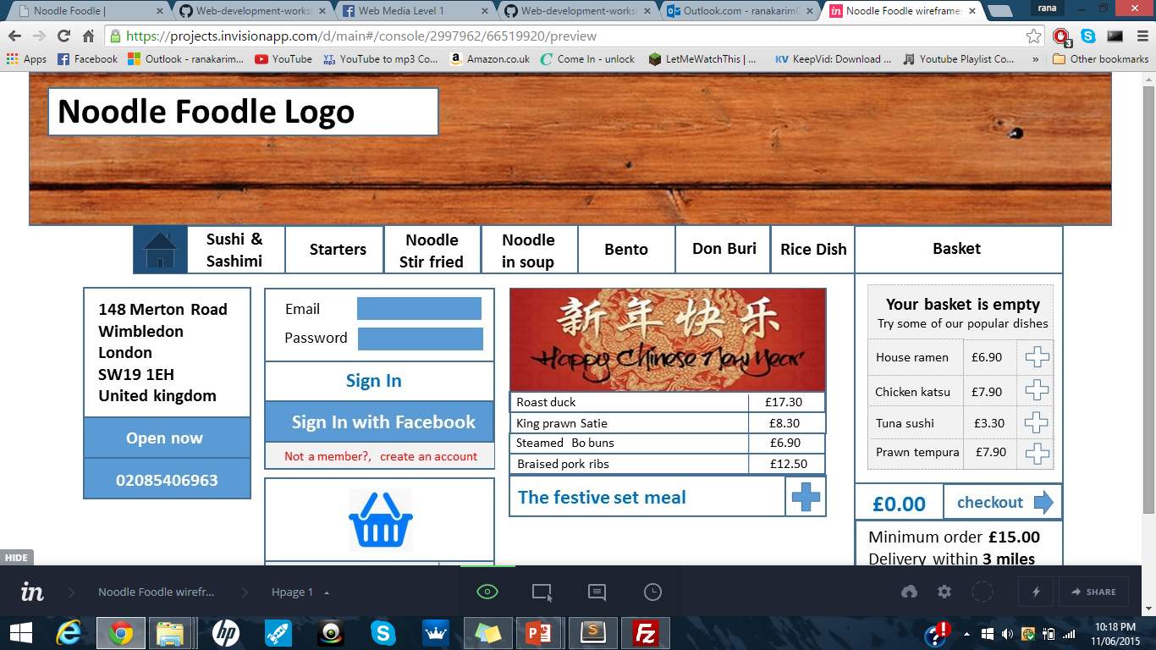
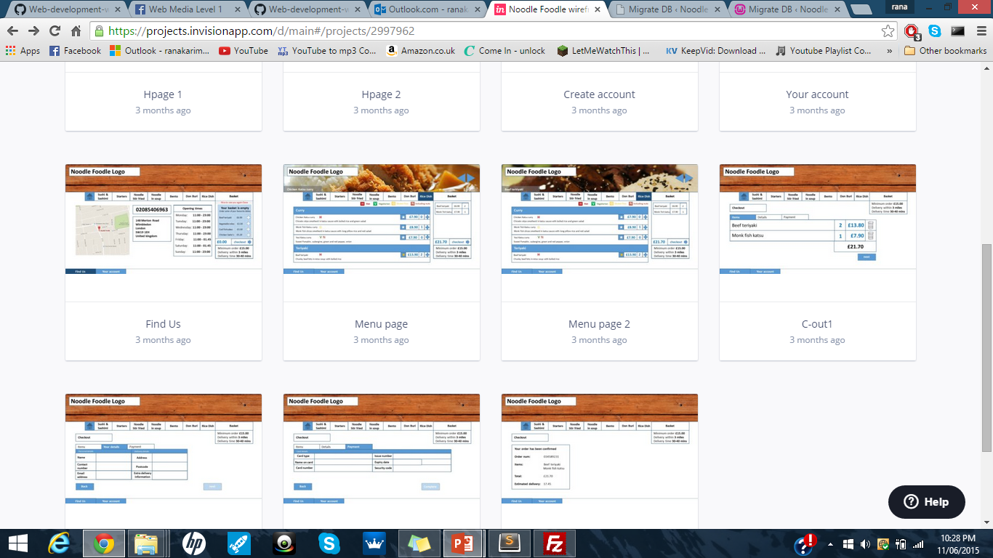


The process (Digital Wireframes)
Took wireframes onto Invision , a digital platform to simulate my website
Link to digital in vision wireframes:
https://projects.invisionapp.com/d/main#/projects/2997962

Slide 8
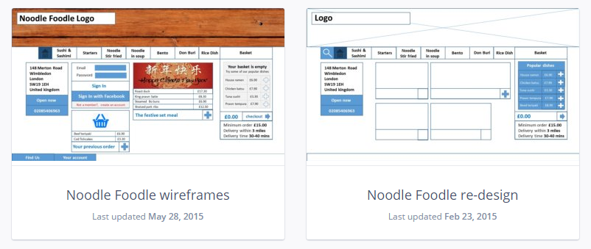
The process (Digital Wireframes)
Developed from “bullshit wireframe” to a more accurate and helpful one. Found it great to use as a guide during construction.

Slide 9
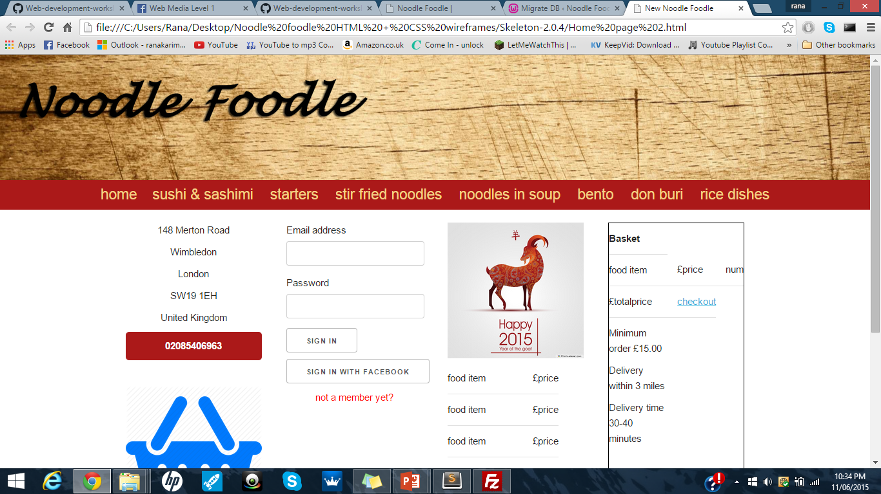
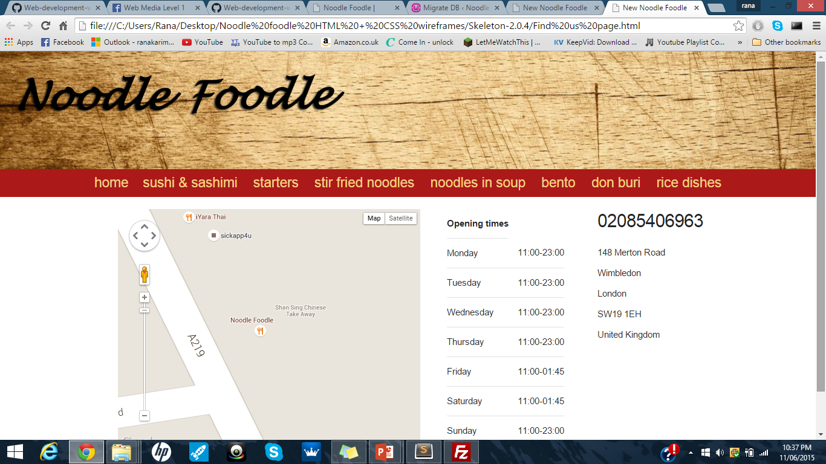
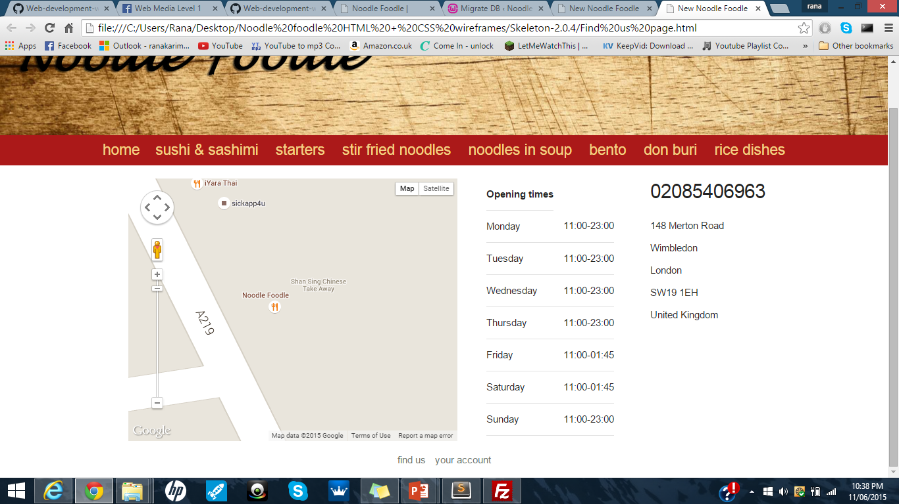
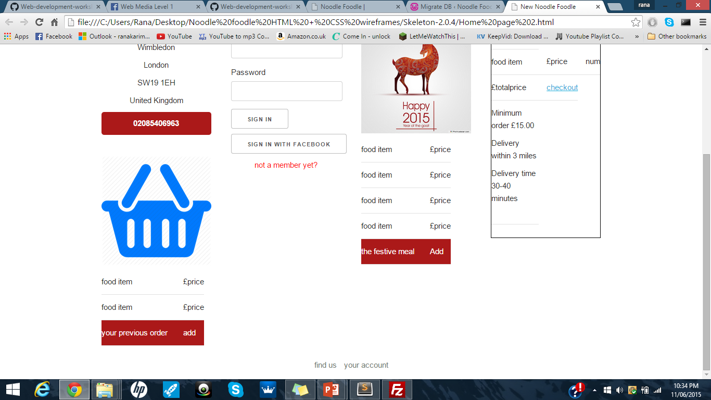
The process (HTML + CSS)
Developing locally
Using skeleton to structure pages
Before WordPress installations

Slide 10
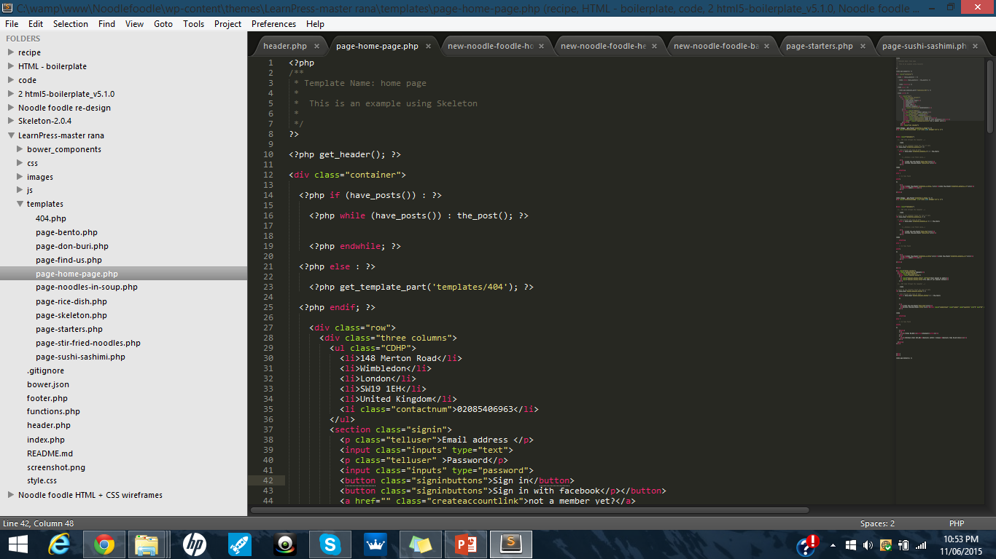
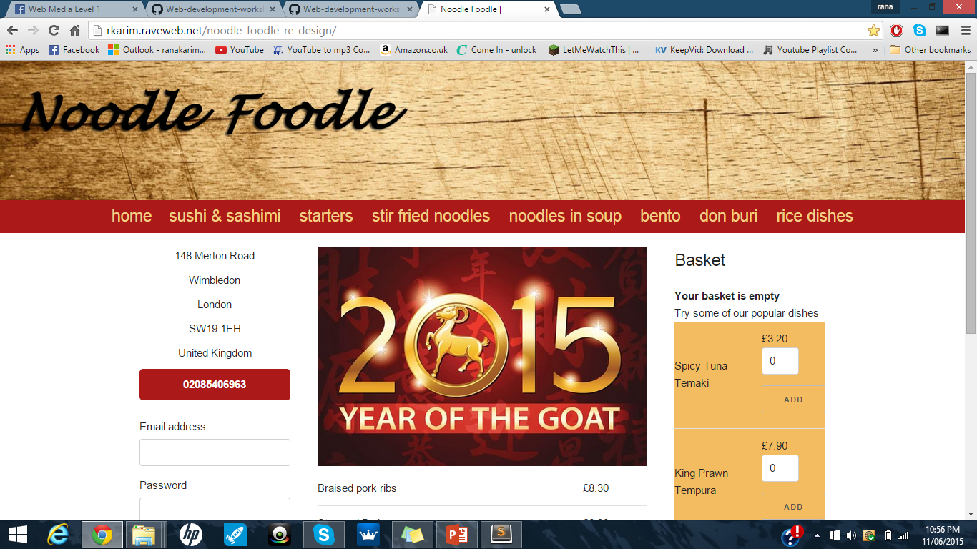
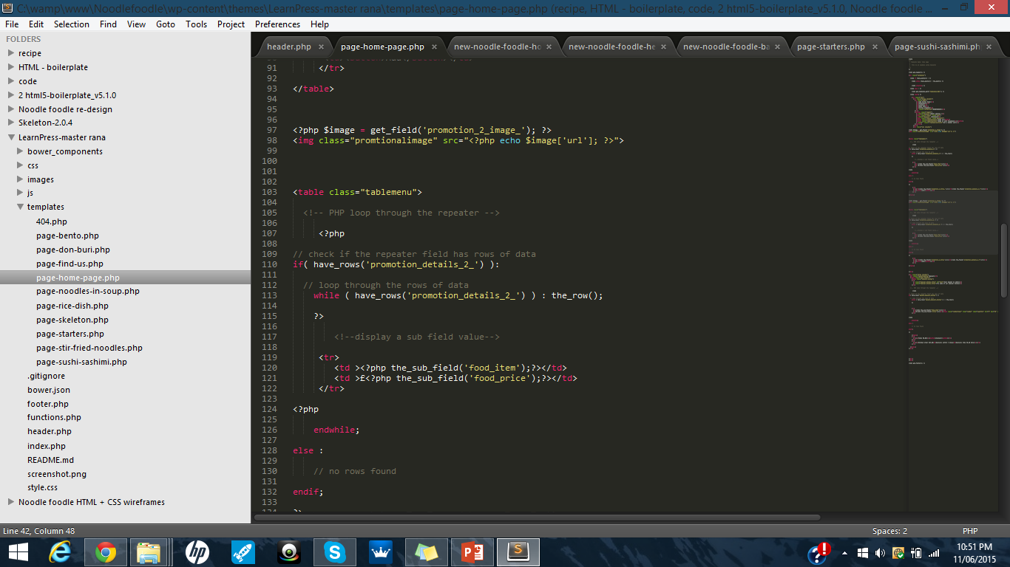
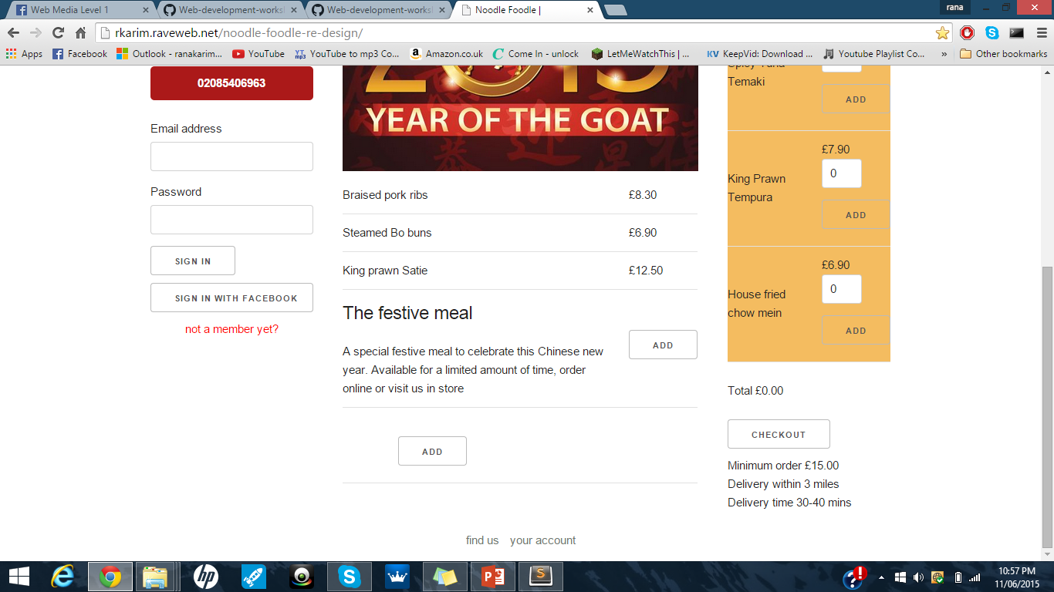
The process (WordPress templates)
Moved onto installing and developing on WordPress locally and started tempting
Allot was pulled over from my HTML wireframes.
Threw php into the mix and used advanced custom fields to make parts dynamic

Slide 11
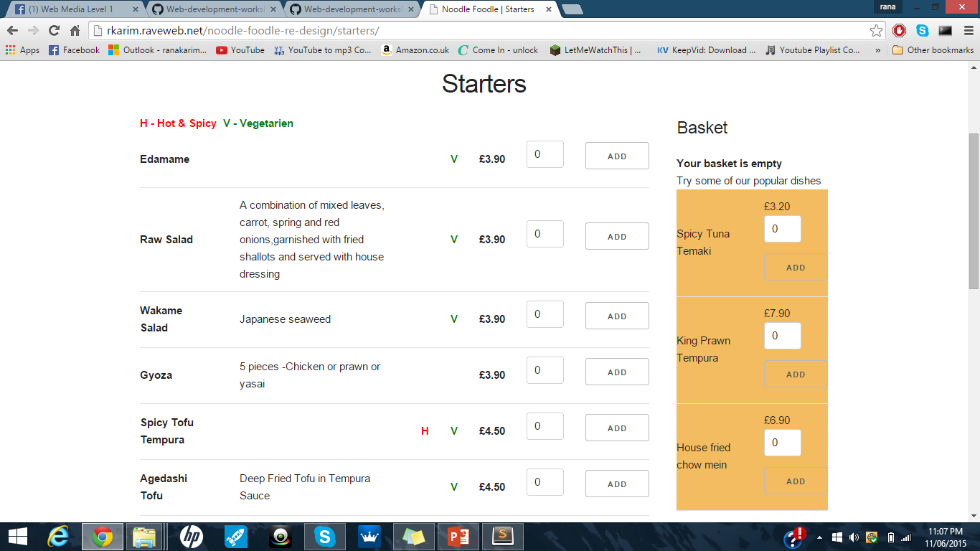
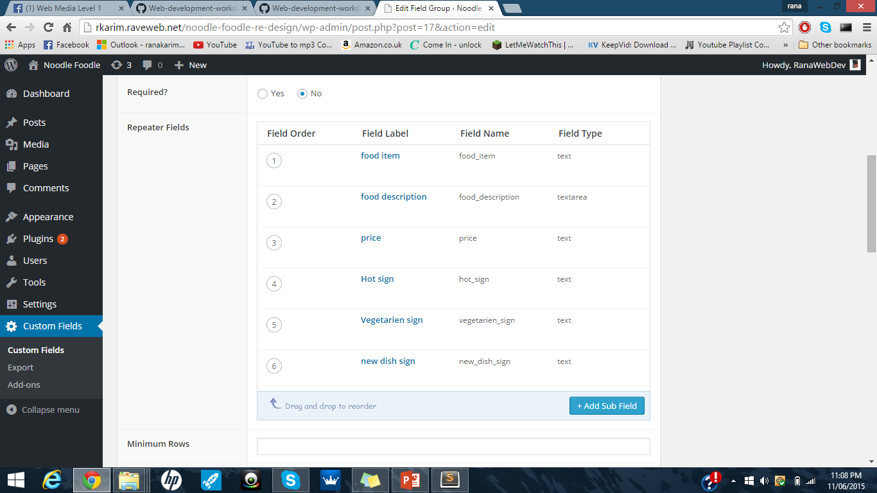
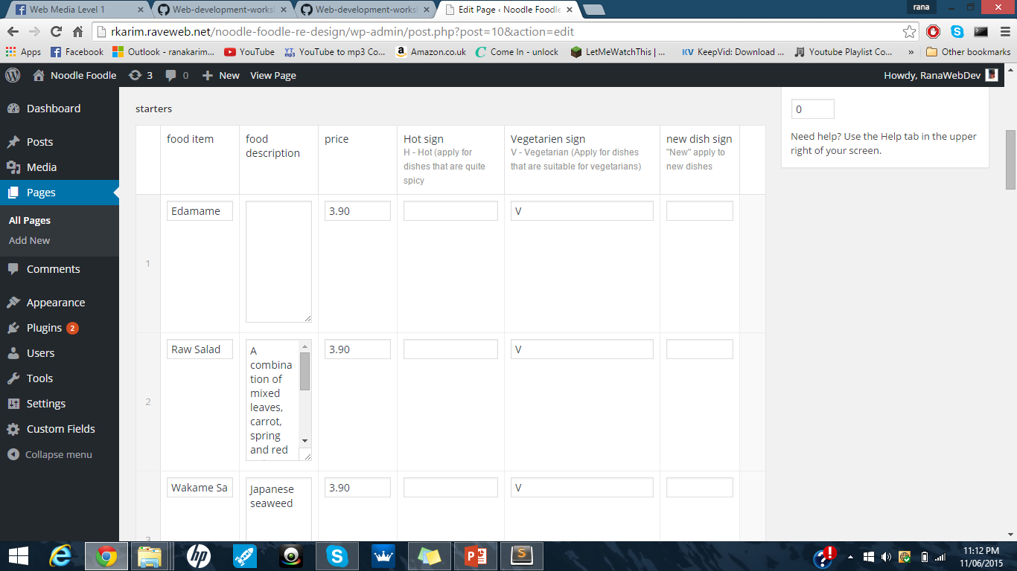
The process (WordPress templates)
Allot of my pages are menu pages
Their all quite similar
I used repeater fields
This Is how it would be laid out

Slide 12
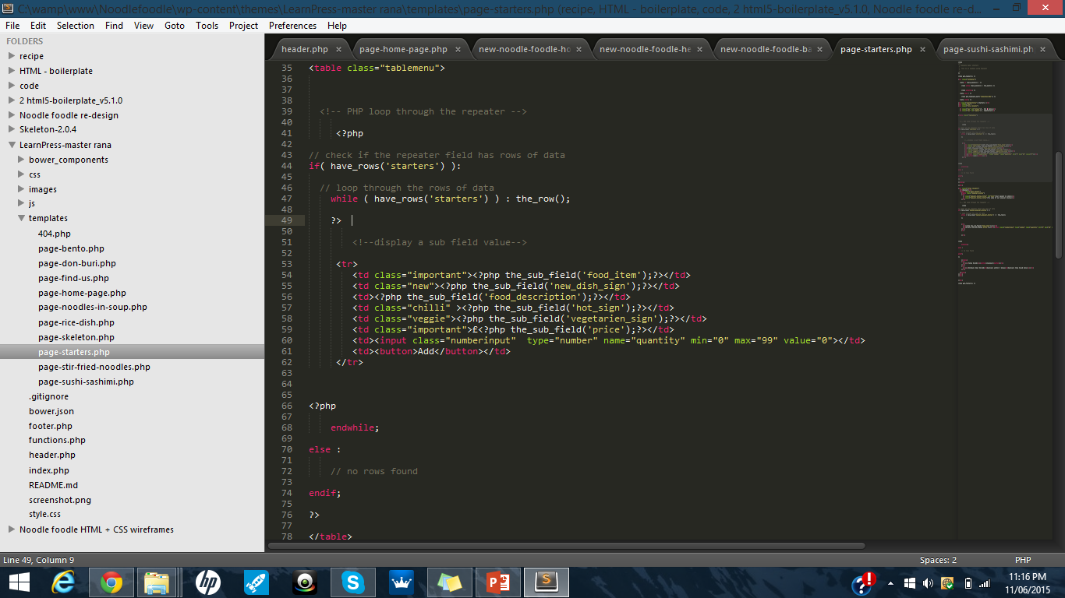
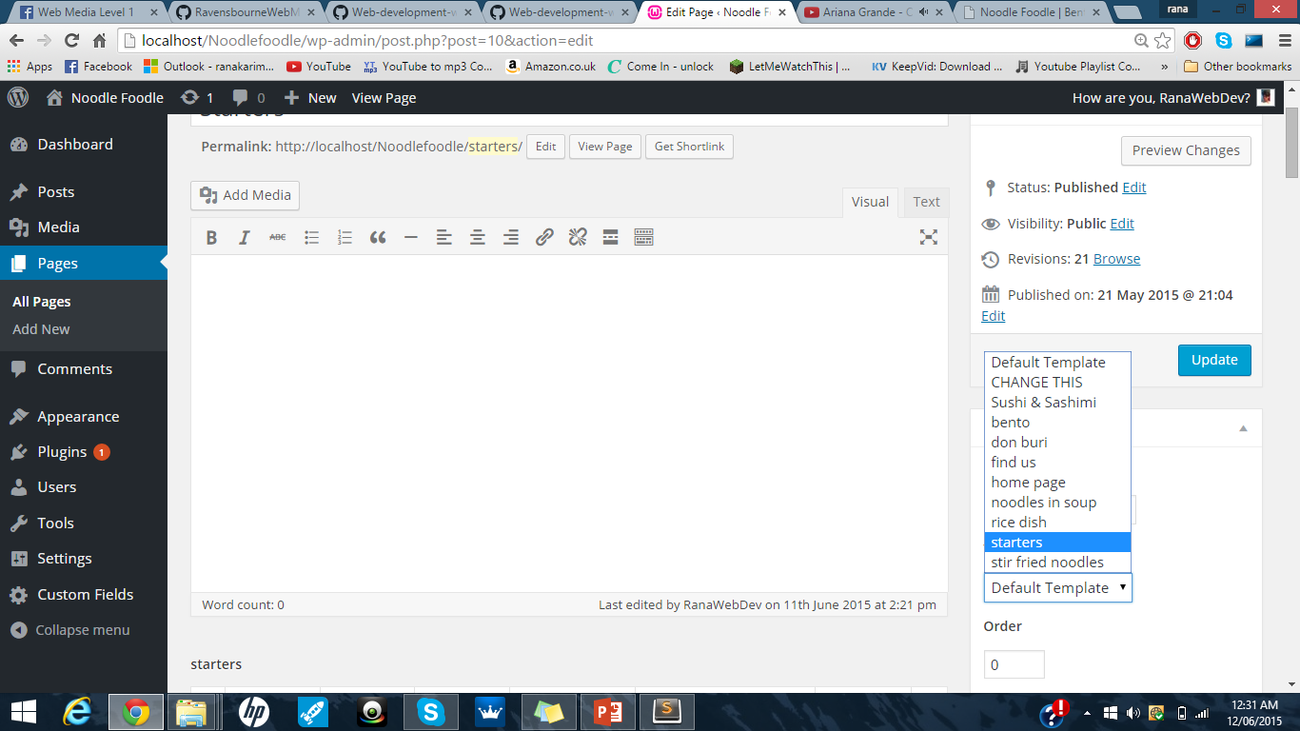
The process (WordPress templates)
Used php within editor to show my custom fields
Broke it down and structured my generated HTML
Applied classes to style generated HTML
Made different templates for each page

Slide 13
The process (WWW)
Lets check out the current website
Link to remote site:
http://rkarim.raveweb.net/noodle-foodle-re-design/

Slide 14



Assessment
- Applied but not fully complete
be online (not just on your computer)
be dynamic (update-able via a CMS)
be responsive (adapting to different screen sizes)
be accessible (for people with disabilities and limited devices)
be visually cohesive and coherent (consistency and connections)
have appropriately structured information
have a style informed by (but not necessarily following) contemporary trends

Slide 15
The Goal
Why Noodle Foodle
After seeing and using the website I didn’t necessarily think it was great and saw a allot of room for improvement. I wasn’t very experienced with coding and thought it would be a good place to start.
What have you I taken away
Greater knowledge of HTML and CSS (structuring my code and visual web pages)
Greater knowledge on Developing locally, hosting websites and FTP clients
Greater understanding of how to use php (ACF)
What have I enjoyed
Designing and developing wireframes
Understanding and using new tools/packages (Skeleton, ACF)
What did I struggle with
jQuery creating functions myself and starting from scratch.
php again starting from scratch and creating my own functions.
Link to full learning outcomes:
https://github.com/RanaKarim/WEB14104/blob/master/students/Rana/Blogging/Week%2017%20(learning%20outcomes)/Markdown-my%20learning%20outcomes.md

Slide 16
Any questions?

